Slide 1

Unit 13 Test Review
Mrs. MacLacklin
5/27/14

Slide 2
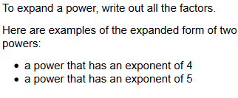


Slide 3
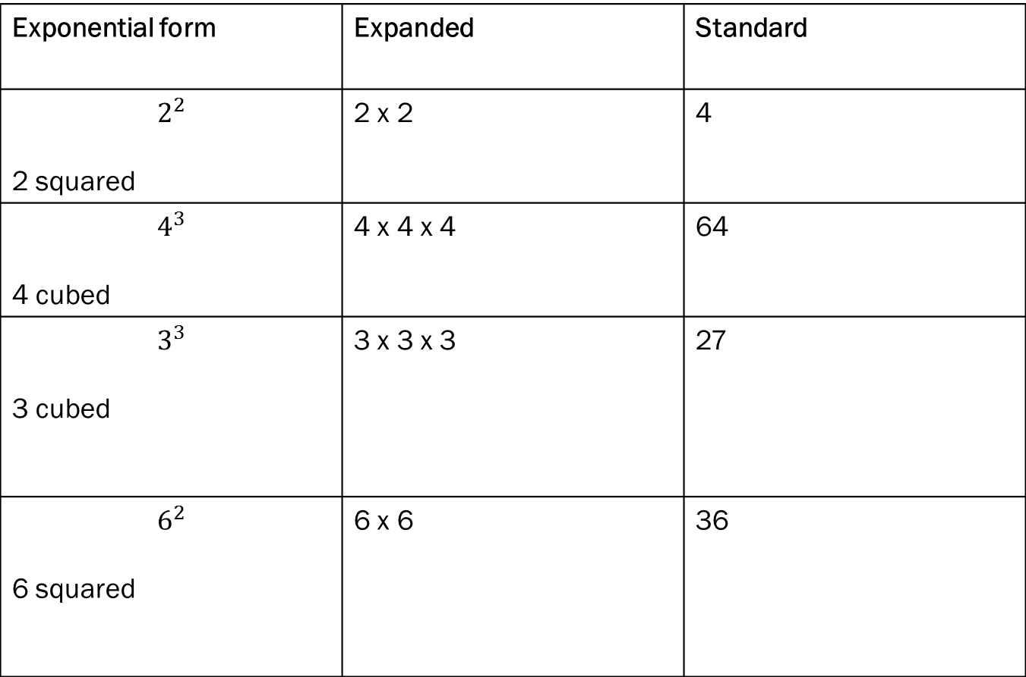
Exponential form | Expanded | Standard
$$2^{2}$$ 2 squared | 2 x 2 | 4
$$4^{3}$$ 4 cubed | 4 x 4 x 4 | 64
$$3^{3}$$ 3 cubed | 3 x 3 x 3 | 27
$$6^{2}$$ 6 squared | 6 x 6 | 36

Slide 4
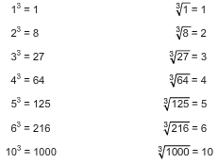
Common Cubes and Cube Roots

Slide 5

Practice
$\sqrt[3]{8}=$ 2
$\sqrt[3]{64}$ = 4
$\sqrt[3]{1000}$ = 10
$\sqrt[3]{216}$ = 6

Slide 6

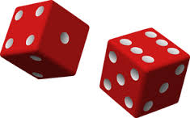
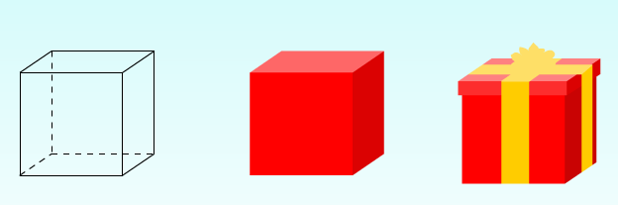
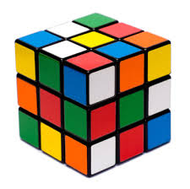
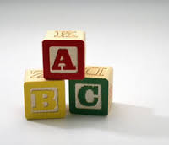
Cube

Slide 7
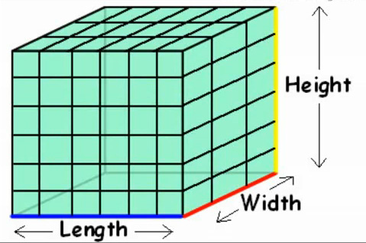
Volume:
The amount of 3-dimensional space an object occupies also called Capacity.
Volume = Length x Width x Height

Slide 8
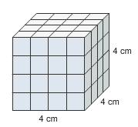
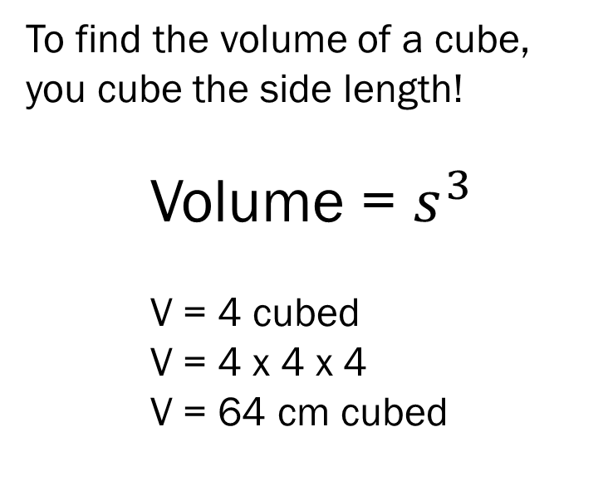
To find the volume of a cube, you cube the side length!
Volume = $s^{3}$
V = 4 cubed
V = 4 x 4 x 4
V = 64 cm cubed

Slide 9
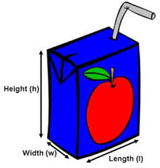

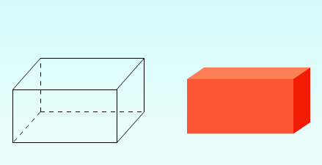
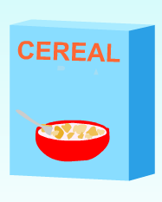
Rectangular Prism

Slide 10
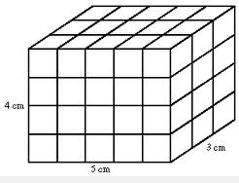
V= L x W x H
V = 5 x 3 x 4
V = 15 x 4
V = 60 cm cubed

Slide 11
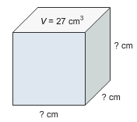

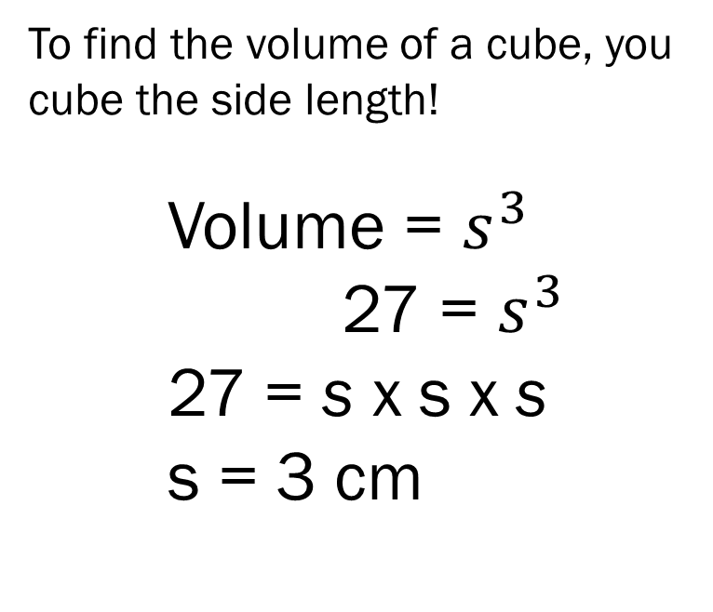
What is the Side Length???
To find the volume of a cube, you cube the side length!
Volume = $s^{3}$
27 = $s^{3}$ 27 = s x s x s
s = 3 cm
What is the cube root of 27?

Slide 12
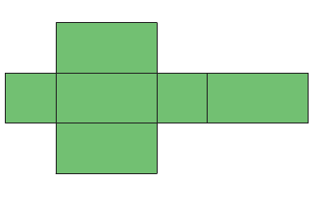
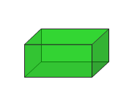
Rectangular Prism Net
A net of a solid figure is a pattern of polygons that can be folded to form that solid figure. Think of unfolding a cardboard box, and then putting it back together!

Slide 13
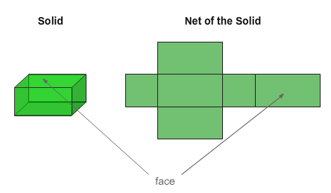
Nets of solids
Nets are made up of polygons (shapes). Each polygon represents a face of the solid shape that the net represents. The number of polygons in a net equals the number of faces in the solid.

Slide 14
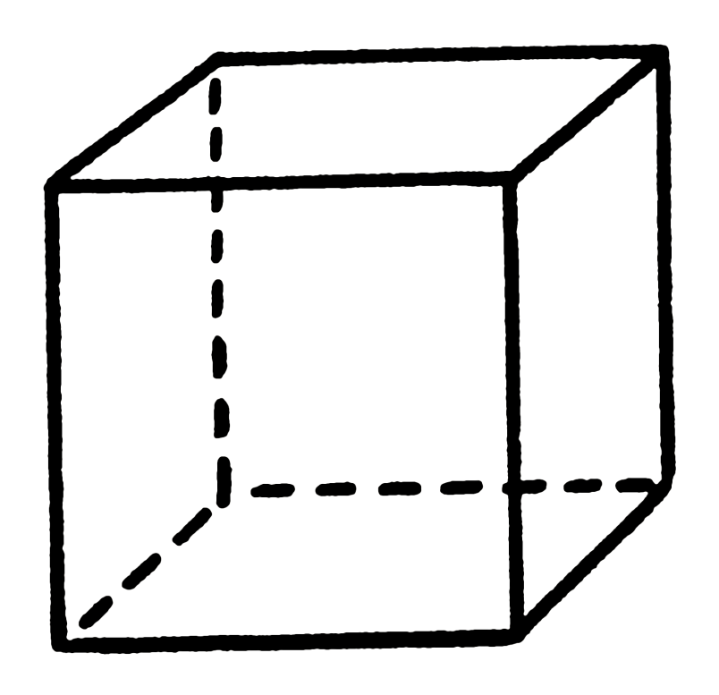
Let’s Draw a Net…
First, how many sides should we have total?
Should they all be the same shape and size?

Slide 15
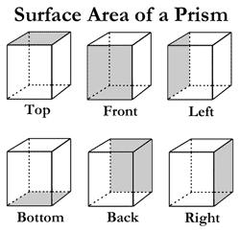
Surface Area
The total area of all of a solid’s faces. Think of painting all the faces of a box. The paint covers the surface area of the box. Surface area is always labeled as units squared.
You can use nets to help you find surface area.

Slide 16
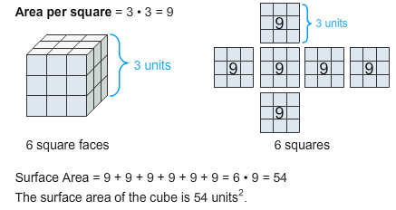
Steps for Finding Surface Area of a Solid
Draw the net.
Find the area of each polygon of the net.
  A = L x W
Calculate the total of these areas.

Slide 17
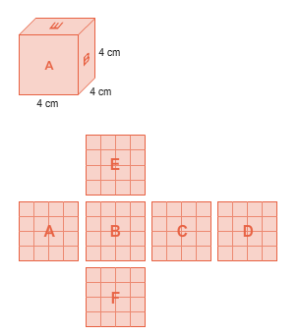
Surface Area: Review
Because a cube has 6 congruent (equal) faces, we can just find the area of one, and multiply!
A = L x W
A = 4 x 4 = 16
Each of the six faces has an area of 16 cm².
6 squares, 16 x 6 = 96
So the total Surface Area is
96 cm².

Slide 18
Surface Area vs Volume
Surface area is the total area of all the surfaces of a solid. Volume is a measure of the amount of space that a solid occupies.
When an everyday situation involves surface area, the discussion is often about how much material is needed to cover a surface of a solid, such as the amount of paint needed to paint a box.
When an everyday situation involves volume, the discussion is about how much space is inside a solid, such as the available space in a box.

Slide 19



Surface Area OR Volume
Miss Smith is wrapping a gift for Mrs. Oakes baby shower! She needs to figure out how much paper she will need to cover the box.
Notes:
Surface area because it is about the material needed to cover the surface.

Slide 20
Mrs. Johnson needs to buy a bucket to fill with water for her horse. She needs to make sure that the bucket is big enough to hold enough water for a whole day.
Surface Area OR Volume
Notes:
Volume because its about the amount of space inside the bucket to be filled.

Slide 21
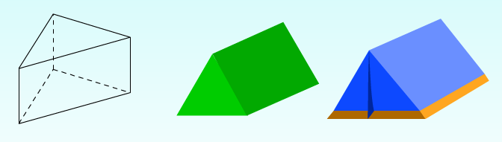


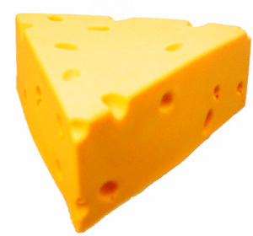
Triangular Prism

Slide 22
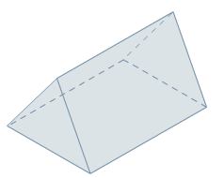
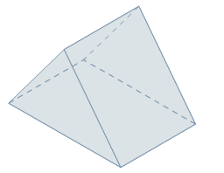
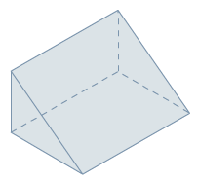
Triangular Prisms
Triangle faces are equilateral:
all 3 rectangular faces
are congruent.
Triangle faces are isosceles:
2 of the rectangular
faces are congruent.
Triangle faces are scalene triangles:
no congruent rectangular faces.

Slide 23
Let’s work some more with
Triangular Prisms!
A triangular prism has 2 congruent triangular bases and 3 rectangular faces.
The rectangular faces may or may not be congruent, so you have to study each triangular prism carefully!!

Slide 24
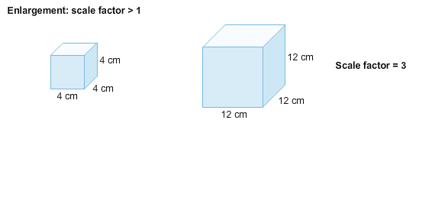
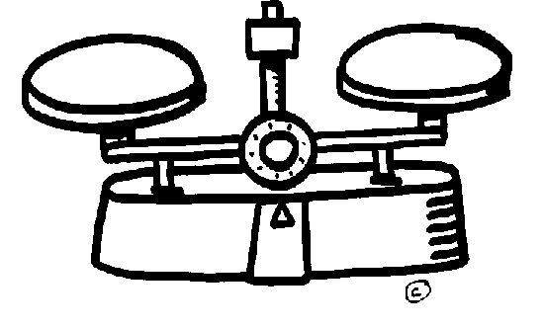
What is the scale?

Slide 25
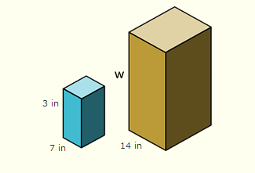
What is the Scale?
6 in
Notes:
2

Slide 26
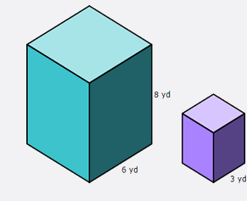

What would be the scale?
2
3
4
5
4 yd
Notes:
A. 2

