Slide 1
Unit 13 Lessons 1-3 Review & Quiz
Mrs. MacLacklin
5/19/14

Slide 2
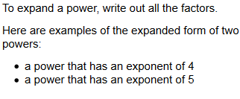
Notes:
Ask students for more examples

Slide 3
Squaring and Cubing
Any number to the second power is said to be squared
$4^{2}$
Any number to the 3rd power is said to be cubed
$$5^{3}$$

Slide 4
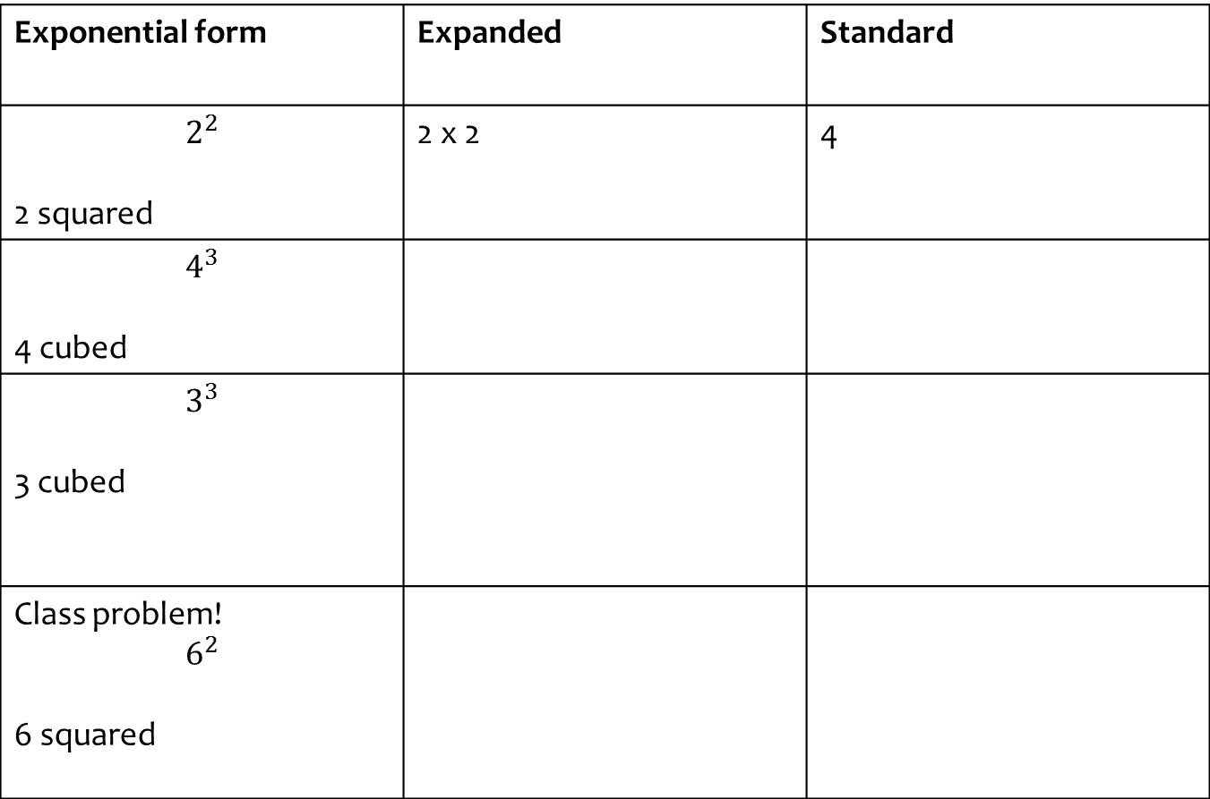
Exponential form | Expanded | Standard
$$2^{2}$$ 2 squared | 2 x 2 | 4
$$4^{3}$$ 4 cubed
$$3^{3}$$ 3 cubed
Class problem! $$6^{2}$$ 6 squared
Notes:
*TAKE ATTENDANCE
4 * 4 * 4 = 64
3 * 3 * 3 = 27
6 * 6 = 36

Slide 5
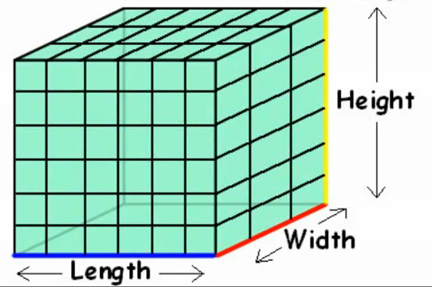
Volume:
The amount of 3-dimensional space an object occupies also called Capacity.
Volume = Length x Width x Height

Slide 6
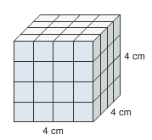
To find the volume of a cube, you cube the side length!
Volume = $s^{3}$
Notes:
V = 4 cubed
V = 4 x 4 x 4
V = 64 cm cubed

Slide 7
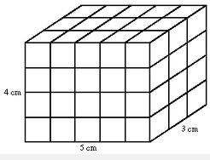
V= L x W x H
Notes:
V = 5 * 3 * 4
V = 15 * 4
V = 60 cm

Slide 8
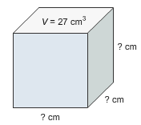
What is the Side Length???
To find the volume of a cube, you cube the side length!
Volume = $s^{3}$
27 = $s^{3}$ 27 = s x s x s
What is the cube root of 27?
Notes:
S = 3 cm

Slide 9
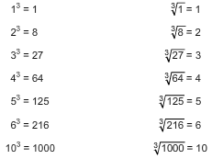
Common Cubes and Cube Roots

Slide 10
Practice
$\sqrt[3]{8}=$ _______
$\sqrt[3]{64}$ = _______
$\sqrt[3]{1000}$ = ______
$\sqrt[3]{216}$ = _______
Notes:
2
4
10
6

Slide 11
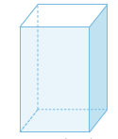
Rectangular and Triangular Prisms:
Triangular Prism
Rectangular Prism
Notes:
If a prism has rectangular bases, it is called a rectangular prism.
If a prism has triangular bases, it is called a triangular prism.
If a prism has bases that are pentagons, it is called a pentagonal prism…you get the idea!

Slide 12
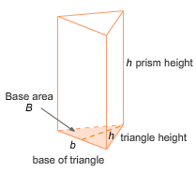
Volume of a Triangular Prism
Notes:
You can use the formula V = Bh to find the volume of any prism; therefore, you can use it to find the volume of triangular prisms.
You just have to remember that bases of a triangular prism are not rectangles.
They are triangles.
You must use the formula for area of a triangle to find the area of the base, B.

Slide 13
Find the Base which is length x width (of the triangle) divided by 2
Then multiply the Base x Height for the Volume
There is your answer! Tada!
14 cm
7 cm
2 cm
Notes:
B = 2 x 7 / 2
B = 14 / 2
B = 7 cm squared
V = 7 x 14
V = 98 cm cubed

Slide 14
Math Unit 13 Quiz:
App Share
Name
10 Questions
Each question is worth 1 point, quiz is worth 10 points
Take your time & do your best!
Green Check when you are done
LINK:
http://my.questbase.com/take.aspx?pin=2856-0925-3938
Notes:
http://my.questbase.com/take.aspx?pin=2856-0925-3938

